Slide 1

CS654: Digital Image Analysis
Lecture 22: Image Restoration - II

Slide 2
Recap of Lecture 21
Image restoration vs. enhancement
What is restoration
Image restoration model
Continuous, discrete formulation
Point spread function
Noise

Slide 3
Outline of Lecture 22
2D discrete domain modeling
Restoration with only noise
Restoration with degradation
Blind deconvolution
Motion Blur
Inverse Filtering

Slide 4
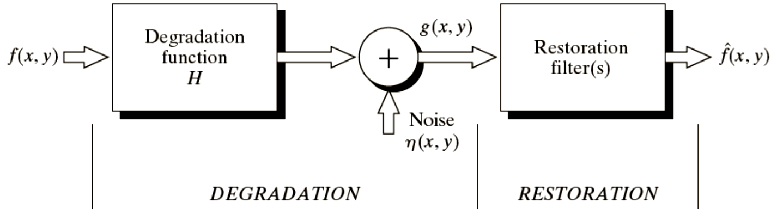
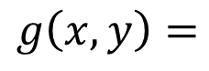
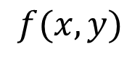

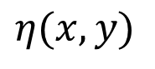

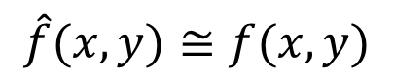
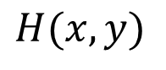
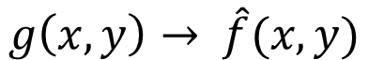
Image restoration pipeline
Images: Gonzalez & Woods, 3rd edition
$$g\left(x,y\right)=$$
$$f(x,y)$$
$$∗$$
$$H(x,y)$$
$$+$$
$$η(x,y)$$
$$g\left(x,y\right)→ \hat{f}(x,y)$$
Target
$$\hat{f}(x,y)≅f(x,y)$$

Slide 5



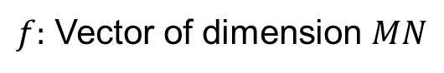



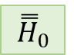
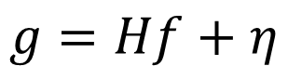
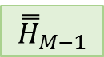



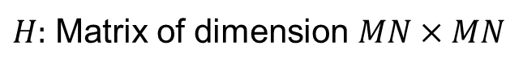
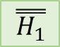


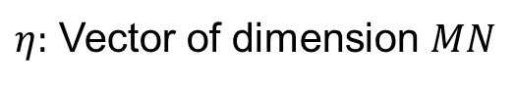

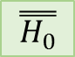

2D Discrete Domain Representation
$f:$ Vector of dimension $MN$
$η:$ Vector of dimension $MN$
$$g=Hf+η$$
$H:$ Matrix of dimension $MN×MN$
$$MN$$
$$\overset{̿}{H_{0}}$$
$$…$$
$$\overset{̿}{H_{1}}$$
$$0$$
$$…$$
$$⋱$$
$$…$$
$$…$$
$${\overset{̿}{H}}_{M−1}$$
$$…$$
$${\overset{̿}{H}}_{0}$$
$$M$$
$$MN$$
$$0$$
$$…$$
$$M$$
Block Circulant matrix

Slide 6
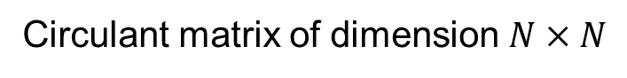
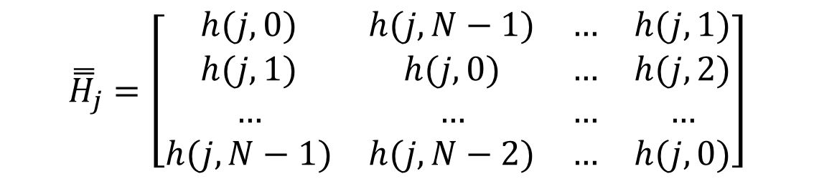
2D Discrete Domain Representation
$${\overset{̿}{H}}_{j}=\left[\begin{matrix}h(j,0) & h(j,N−1) & … & h(j,1) \\ h(j,1) & h(j,0) & … & h(j,2) \\ … & … & … & … \\ h(j,N−1) & h(j,N−2) & … & h(j,0)\end{matrix}\right]$$
Circulant matrix of dimension $N×N$

Slide 7
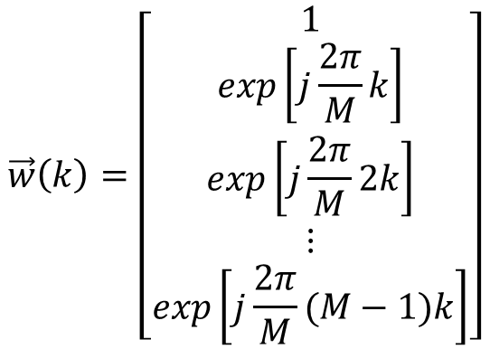
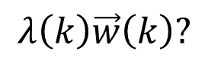
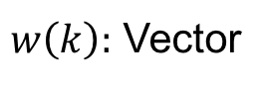
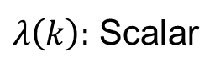
Image restoration: 1D case
Let,
$λ\left(k\right):$ Scalar
$$λ\left(k\right)=h\left(0\right)+h\left(M−1\right)exp\left[j\frac{2π}{M}k\right]+…+h(1)exp\left[j\frac{2π}{M}(M−1)k\right]$$
$$\vec{w}\left(k\right)=\left[\begin{matrix}1 \\ exp\left[j\frac{2π}{M}k\right] \\ exp\left[j\frac{2π}{M}2k\right] \\ ⋮ \\ exp\left[j\frac{2π}{M}(M−1)k\right]\end{matrix}\right]$$
Let,
$w\left(k\right):$ Vector
What happens if we do
$$λ\left(k\right)\vec{w}\left(k\right)?$$

Slide 8
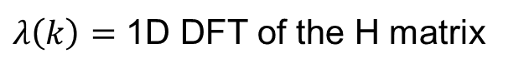
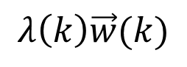
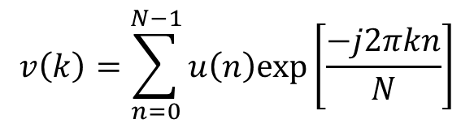
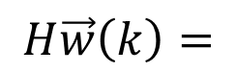
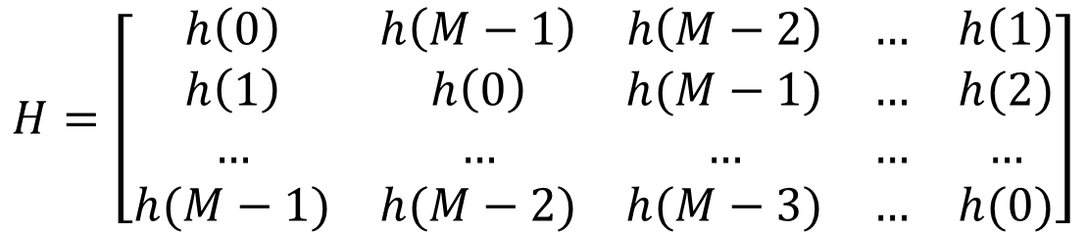
Image restoration
$$H=\left[\begin{matrix}h\left(0\right) & h\left(M−1\right) & h\left(M−2\right) & … & h\left(1\right) \\ h\left(1\right) & h\left(0\right) & h(M−1) & … & h(2) \\ … & … & … & … & … \\ h(M−1) & h(M−2) & h(M−3) & … & h(0)\end{matrix}\right]$$
$$H\vec{w}\left(k\right)=$$
$$λ\left(k\right)\vec{w}(k)$$
$\vec{w}\left(k\right)$: Eigen vector of $H$; $λ\left(k\right)$: Its corresponding Eigen value
$$λ\left(k\right)=h\left(0\right)+h\left(M−1\right)exp\left[j\frac{2π}{M}k\right]+…+h(1)exp\left[j\frac{2π}{M}(M−1)k\right]$$
$$v\left(k\right)=\sum_{n=0}^{N−1}{u\left(n\right)exp⁡\left[\frac{−j2πkn}{N}\right]}$$
DFT :
$λ\left(k\right)=$ 1D DFT of the H matrix

Slide 9
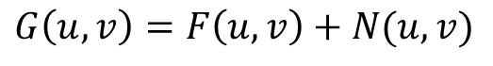
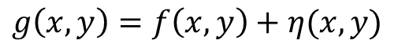
Restoration in presence of only noise
Spatial domain:
$$g\left(x,y\right)=f\left(x,y\right)+η(x,y)$$
Frequency domain:
$$G\left(u,v\right)=F\left(u,v\right)+N(u,v)$$
Spatial filtering is the choice when additive random noise is present
Mean filter
Median Filter (order statistics),max, min, mid-point
Bandpass, band-reject filters
Adaptive filters

Slide 10
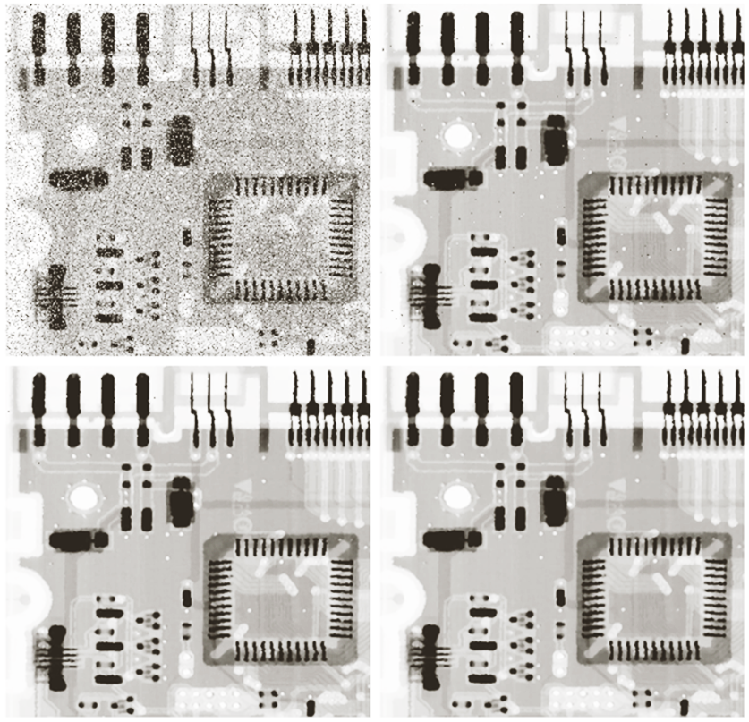
Examples

Slide 11
In presence of degradation
Degradation (spatial domain) = conv(PSF, image) + noise
Degradation (Freq. domain) = H(PSF).H(image) + H(noise) where H=transformation function
Image deconvolution
Deconvolution filters

Slide 12
Degradation estimation
Estimation
Observation
Experimentation
Mathematical Modeling
Blind deconvolution
A technique that permits recovery of the target scene from distorted image(s) in the presence of a unknown point spread function (PSF)

Slide 13

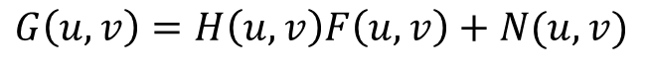

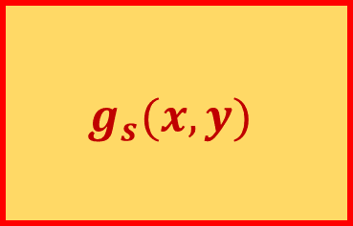
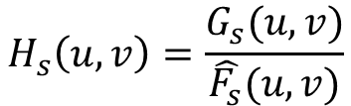
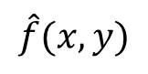
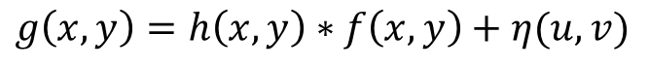
Estimation by Observation
Spatial domain:
$$g\left(x,y\right)=h\left(x,y\right)∗f\left(x,y\right)+η(u,v)$$
Frequency domain:
$$G\left(u,v\right)=H\left(u,v\right)F\left(u,v\right)+N(u,v)$$
Processed sub-image:
$$\hat{f}(x,y)$$
$$g_{s}(x,y)$$
$$H_{s}\left(u,v\right)=\frac{G_{s}(u,v)}{\hat{F_{s}}(u,v)}$$
How to choose $g_{s}\left(x,y\right)?$
What is the dimension of $H_{s}\left(u,v\right)$?

Slide 14






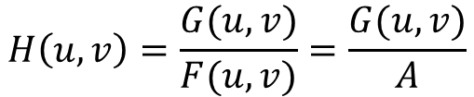
Estimation by Experimentation
Images: Gonzalez & Woods, 3rd edition
Scene
Acquired Image
Degradation function ➔ Impulse response
Impulse simulation
Degradation function estimation
Simulated impulse
Impulse response
$$H\left(u,v\right)=\frac{G(u,v)}{F(u,v)}=\frac{G(u,v)}{A}$$

Slide 15
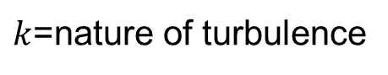

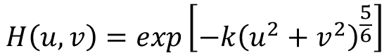


Estimation by Mathematical Modeling
Images: Gonzalez & Woods, 3rd edition
Physical characteristics of atmospheric turbulence
$$k=0.0025$$
$$H\left(u,v\right)=exp\left[−k{\left(u^{2}+v^{2}\right)}^{\frac{5}{6}}\right]$$
$k$=nature of turbulence
$$k=0.001$$
$$k=0.00025$$

Slide 16
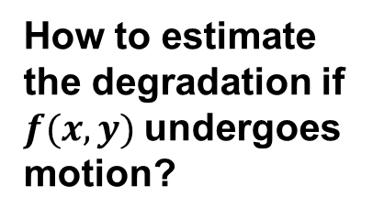
Estimation from Basic Principles
Without motion
With motion
Camera
Camera
How to estimate the degradation if $f(x,y)$undergoes motion?

Slide 17
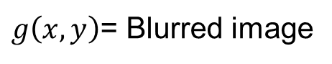
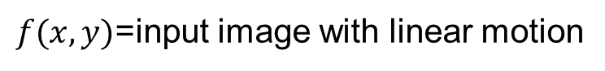
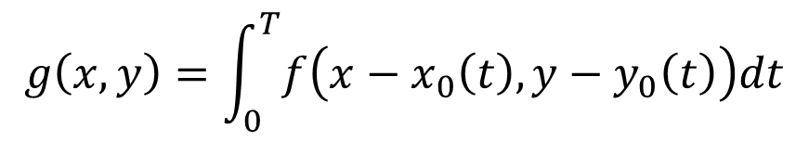
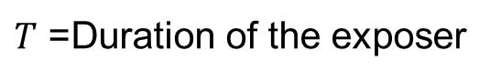
Uniform linear motion blur
$f(x,y)$=input image with linear motion
$x_{0}(t)$=Time varying component along $x$ direction
$y_{0}(t)$=Time varying component along $y$direction
$T$ =Duration of the exposer
$$g\left(x,y\right)=\int_{0}^{T}{f\left(x−x_{0}\left(t\right),y−y_{0}\left(t\right)\right)dt}$$
$g\left(x,y\right)$= Blurred image

Slide 18
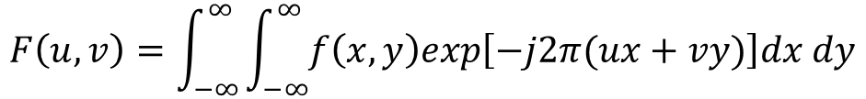
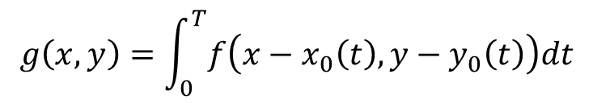
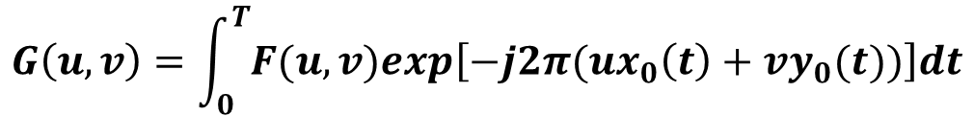
Uniform linear motion blur
$$g\left(x,y\right)=\int_{0}^{T}{f\left(x−x_{0}\left(t\right),y−y_{0}\left(t\right)\right)dt}$$
$$F\left(u,v\right)=\int_{−∞}^{∞}{\int_{−∞}^{∞}{f\left(x,y\right)exp\left[−j2π(ux+vy)\right]dx dy}}$$
2-D Fourier Transform:
$$G\left(u,v\right)=\int_{−∞}^{∞}{\int_{−∞}^{∞}{\left[\int_{0}^{T}{f\left(x−x_{0}\left(t\right),y−y_{0}\left(t\right)\right)dt}\right]exp\left[−j2π(ux+vy)\right]dx dy}}$$
$$G\left(u,v\right)=\int_{0}^{T}{\left[\int_{−∞}^{∞}{\int_{−∞}^{∞}{f\left(x−x_{0}\left(t\right),y−y_{0}\left(t\right)\right)exp\left[−j2π(ux+vy)\right]dx dy}}\right]dt}$$
$$G\left(u,v\right)=\int_{0}^{T}{F(u,v)exp\left[−j2π(ux_{0}\left(t\right)+vy_{0}(t))\right]dt}$$

Slide 19
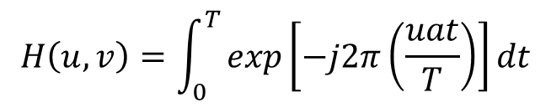
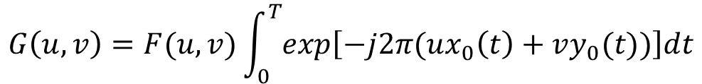
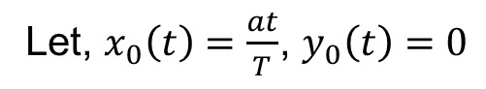
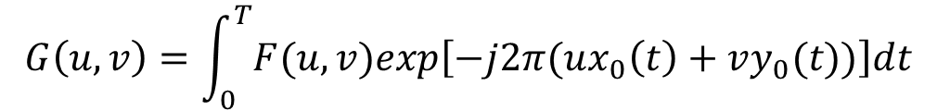
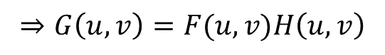


Uniform linear motion blur
$$G\left(u,v\right)=\int_{0}^{T}{F(u,v)exp\left[−j2π(ux_{0}\left(t\right)+vy_{0}(t))\right]dt}$$
$$G\left(u,v\right)=F(u,v)\int_{0}^{T}{exp\left[−j2π(ux_{0}\left(t\right)+vy_{0}(t))\right]dt}$$
$∵F(u,v)$ is independent of $t$
Let, $H\left(u,v\right)=\int_{0}^{T}{exp\left[−j2π(ux_{0}\left(t\right)+vy_{0}(t))\right]dt}$
$$⇒G\left(u,v\right)=F(u,v)H\left(u,v\right)$$
Let, $x_{0}\left(t\right)=\frac{at}{T}$, $y_{0}\left(t\right)=0$
$$H\left(u,v\right)=\int_{0}^{T}{exp\left[−j2π\left(\frac{uat}{T}\right)\right]dt}$$

Slide 20
Example
Images: Gonzalez & Woods, 3rd edition
Input Image
Motion Blurred Image (a=b=0.1, T=1)

Slide 21




Inverse Filtering
Simplest approach for image restoration – direct inverse filtering
$$\hat{F}\left(u,v\right)=\frac{G(u,v)}{H(u,v)}$$
Frequency domain:
$$G\left(u,v\right)=F\left(u,v\right)+N(u,v)$$
$$\hat{F}\left(u,v\right)=F\left(u,v\right)+\frac{N(u,v)}{H(u,v)}$$
$N\left(u,v\right)$ is unknown
If $H(u,v)$ is small, $\hat{F}\left(u,v\right)$ is dominated by the ratio $\frac{N(u,v)}{H(u,v)}$

Slide 22


Example
Full filter
CR = 40
CR=70
CR = 85
Input image

Slide 23
Thank you
Next Lecture: Image Restoration

